Slide 1
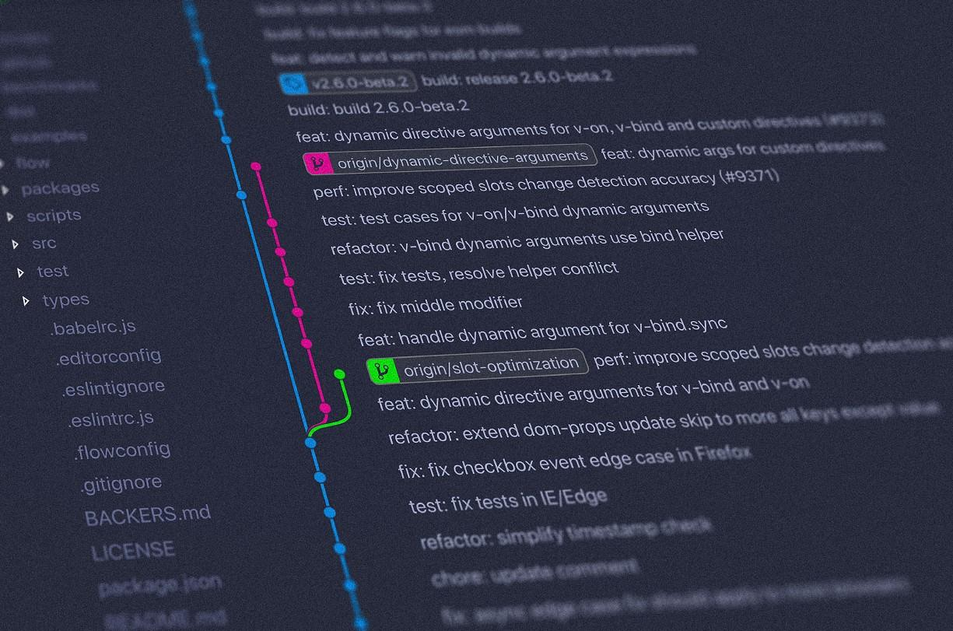
Git Training

Slide 2

Tinaël Devresse
Meet your speaker
Studies:
Hénallux
Jobs:
IT Consultant @ Capyx
BNP Paribas Fortis (.NET developer & IT coach)
MaxiToys (.NET developer & IT coach)
Teacher @ Henallux
Former jobs:
Developer @ CESI
Developer @ PwC

Slide 3
Table of Contents
Version Control
The “Git” Tool
Workflows
Apps & Websites

Slide 4
Version Control
What is it?
What are the advantages?

Slide 5
What is it?
Practice of tracking & managing changes of files
Every modification
Line by line
Backup
History
Version Control

Slide 6
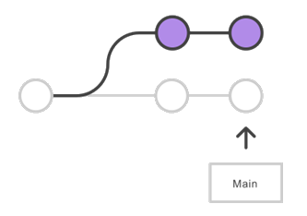
What are the advantages?
History of every file
Traceability
Branching & merging
Version Control

Slide 7
What are the advantages?
Possible to work without a Version Control System
Not advised as highly subject to risks
The question is not
whether to use version control
but which VCS to use?
Version Control
The question is
whether to use version control or not ?
Notes:
https://bitbucket.org/product/version-control-software

Slide 8
The “Git” Tool
What is it?
How does it work?
Why should you use it?

Slide 9
What is it?
Version Control System (VCS)
Most widely used
Actively maintained
Open source
Distributed
Developed in 2005
By Linus Torvalds
The “Git” Tool

Slide 10


How does it work?
git clone <url>
The “Git” Tool
Repository
Your computer
A server
Command
git clone = clone a repository
Terminology
Repository = a collection of information, files and folders included
Notes:
https://dev.to/milu_franz/git-explained-the-basics-igc https://towardsdatascience.com/an-easy-beginners-guide-to-git-2d5a99682a4c https://medium.com/chaya-thilakumara/an-introduction-to-git-for-beginners-c97e701cecf9 https://dev.to/erikaheidi/series/4483 https://nvie.com/posts/a-successful-git-branching-model/ http://igm.univ-mlv.fr/~dr/XPOSE2011/foucault/concepts.php
https://medium.com/@ashk3l/a-visual-introduction-to-git-9fdca5d3b43a <- !!!

Slide 11


How does it work?
Local repository
Staging area
Working folder
git add
Changed files
The “Git” Tool
Command
git add = move file from unstaged to staged state
Terminology
Local Repository = a clone of the remote repository
Remote Repository = the collection of information, files and folders stored “elsewhere”
Working folder = the folder in which you interact with files and folders
Staging area = a virtual area, like a boarding zone in airport, where the files you select are waiting to be sent to the Remote repo
Notes:
https://dev.to/milu_franz/git-explained-the-basics-igc https://towardsdatascience.com/an-easy-beginners-guide-to-git-2d5a99682a4c https://medium.com/chaya-thilakumara/an-introduction-to-git-for-beginners-c97e701cecf9 https://dev.to/erikaheidi/series/4483 https://nvie.com/posts/a-successful-git-branching-model/ http://igm.univ-mlv.fr/~dr/XPOSE2011/foucault/concepts.php
https://medium.com/@ashk3l/a-visual-introduction-to-git-9fdca5d3b43a <- !!!

Slide 12
How does it work?
Remote repository
Commit 70e0867
The “Git” Tool
git commit
Command
git commit = wrap the staged area into a specific package identified by a number (hash)
Terminology
Commit = a collection of changes (files & metadata about the changes including a description of the commit written by the developer)
Notes:
https://dev.to/milu_franz/git-explained-the-basics-igc https://towardsdatascience.com/an-easy-beginners-guide-to-git-2d5a99682a4c https://medium.com/chaya-thilakumara/an-introduction-to-git-for-beginners-c97e701cecf9 https://dev.to/erikaheidi/series/4483 https://nvie.com/posts/a-successful-git-branching-model/ http://igm.univ-mlv.fr/~dr/XPOSE2011/foucault/concepts.php
https://medium.com/@ashk3l/a-visual-introduction-to-git-9fdca5d3b43a <- !!!

Slide 13
How does it work?
Remote repository
Commit 70e0867
The “Git” Tool
git push
Command
git push = send the local commits to the remote repository
Notes:
https://dev.to/milu_franz/git-explained-the-basics-igc https://towardsdatascience.com/an-easy-beginners-guide-to-git-2d5a99682a4c https://medium.com/chaya-thilakumara/an-introduction-to-git-for-beginners-c97e701cecf9 https://dev.to/erikaheidi/series/4483 https://nvie.com/posts/a-successful-git-branching-model/ http://igm.univ-mlv.fr/~dr/XPOSE2011/foucault/concepts.php
https://medium.com/@ashk3l/a-visual-introduction-to-git-9fdca5d3b43a <- !!!

Slide 14
How does it work?
git fetch
Commit 70e0867
The “Git” Tool
git pull
Command
git fetch = check if there are changes on the remote repository that are not on the local repository
git pull = pull last changes from repository
Notes:
https://dev.to/milu_franz/git-explained-the-basics-igc https://towardsdatascience.com/an-easy-beginners-guide-to-git-2d5a99682a4c https://medium.com/chaya-thilakumara/an-introduction-to-git-for-beginners-c97e701cecf9 https://dev.to/erikaheidi/series/4483 https://nvie.com/posts/a-successful-git-branching-model/ http://igm.univ-mlv.fr/~dr/XPOSE2011/foucault/concepts.php
https://medium.com/@ashk3l/a-visual-introduction-to-git-9fdca5d3b43a <- !!!

Slide 15
How does it work?
Remote repository
Remote repository
git clone
“main” branch
git branch <name>
git checkout <name>
OR
git checkout –b <name>
“main” branch
The “Git” Tool
“name” branch
Command
git branch = create a branch
git checkout = change from the current branch to the specified one
Terminology
Branch = a separate environment within a repository
Notes:
https://dev.to/milu_franz/git-explained-the-basics-igc https://towardsdatascience.com/an-easy-beginners-guide-to-git-2d5a99682a4c https://medium.com/chaya-thilakumara/an-introduction-to-git-for-beginners-c97e701cecf9 https://dev.to/erikaheidi/series/4483 https://nvie.com/posts/a-successful-git-branching-model/ http://igm.univ-mlv.fr/~dr/XPOSE2011/foucault/concepts.php
https://medium.com/@ashk3l/a-visual-introduction-to-git-9fdca5d3b43a <- !!!

Slide 16
How does it work?
Want to know more in depth?
Read the web!
clone & init
add
commit & --amend
push
pull
merge
rebase
stash
checkout
branch & -D
reset
Fetch
…
Repository
Fork
HEAD
Hook
Branch
Pull Request
Tag
Working tree
Commit
.gitignore
CI/CD
...
The “Git” Tool
https://www.atlassian.com/git
Notes:
https://dev.to/milu_franz/git-explained-the-basics-igc https://towardsdatascience.com/an-easy-beginners-guide-to-git-2d5a99682a4c https://medium.com/chaya-thilakumara/an-introduction-to-git-for-beginners-c97e701cecf9 https://dev.to/erikaheidi/series/4483 https://nvie.com/posts/a-successful-git-branching-model/ http://igm.univ-mlv.fr/~dr/XPOSE2011/foucault/concepts.php
https://medium.com/@ashk3l/a-visual-introduction-to-git-9fdca5d3b43a <- !!! https://www.atlassian.com/git

Slide 17
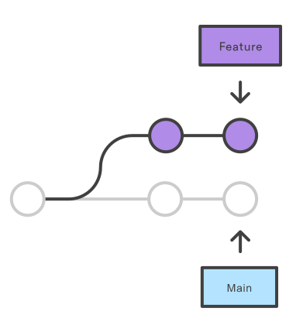
Why should you use it?
Branching capabilities
Isolated environment for every change to your codebase
Main branch = production-ready code
The “Git” Tool

Slide 18
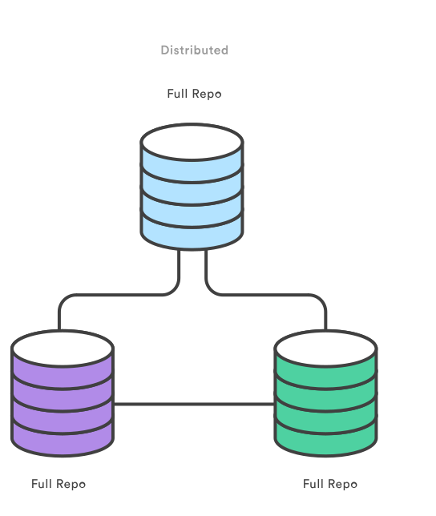
Why should you use it?
Distributed development
Complete local environment
Full history
The “Git” Tool

Slide 19
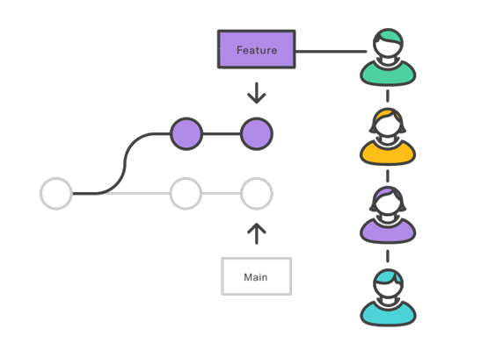
Why should you use it?
Pull Requests
Enhanced feature offered by source code management tools
Easier to keep track of changes
Allows discussions
To ask for help when stuck
As a formal code-review
The “Git” Tool

Slide 20
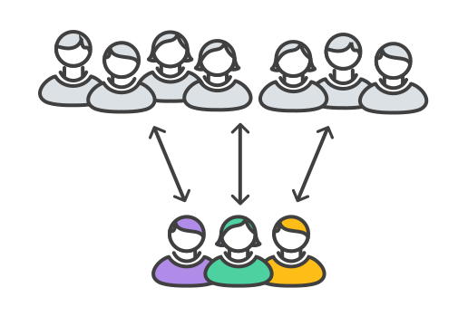
Why should you use it?
Community
No need to train new hires
The “Git” Tool

Slide 21
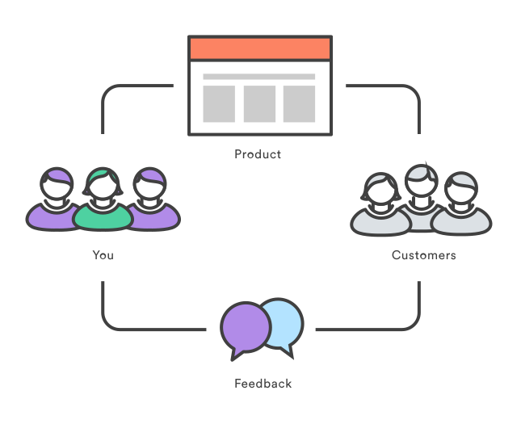
Why should you use it?
Faster Release Cycle
Result of the previous points
Facilitates the agile workflow (smaller changes more frequently)
The “Git” Tool

Slide 22
The Workflows
A word on workflows
Centralized Workflow & Feature Branching
Gitflow Workflow
GitHub Workflow
Trunk-based Development

Slide 23
A word on workflows
Workflows are usually branching strategy
Meant to describe how to use branches via a flow
The Workflows

Slide 24
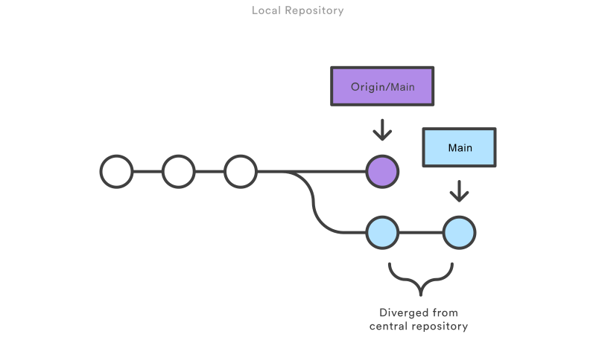
Centralized Workflow & Feature Branching
Everybody works on the same branch
Before pushing, you need to merge locally
This means: manage merge conflicts
The Workflows

Slide 25

Centralized Workflow & Feature Branching
Everybody works on a branch
You merge your branch once you’re done
!! Possible (but avoidable) merge conflicts
The Workflows

Slide 26
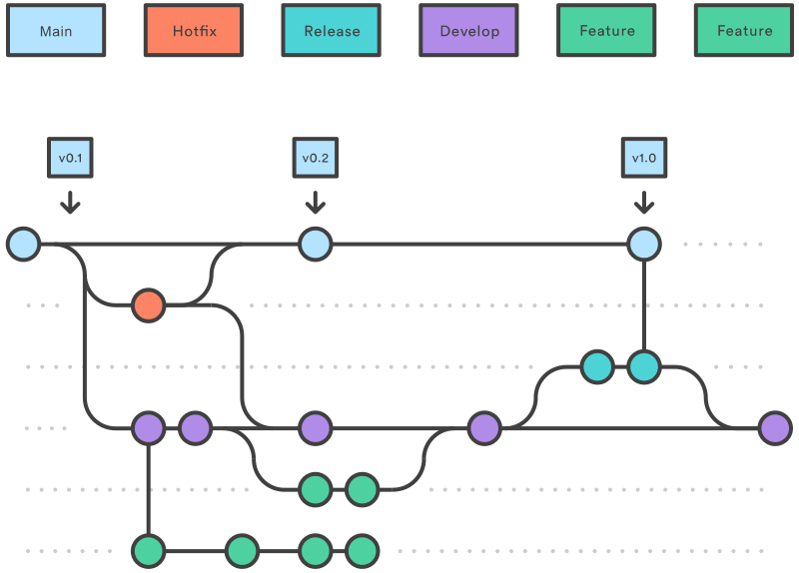
Gitflow Workflow
For bigger companies
“develop” from “main”
“feature” from “develop”
When “feature” is complete, merged in “develop”
Enough features, then “release” from “develop”
When “release” is done, merged in “develop” and “main”
If issue in “main”, “hotfix” from “main”
When “hotfix” is complete, merged in “develop” and “main”
The Workflows

Slide 27
GitHub Workflow
https://hunteroi.github.io/github-flow
The Workflows

Slide 28
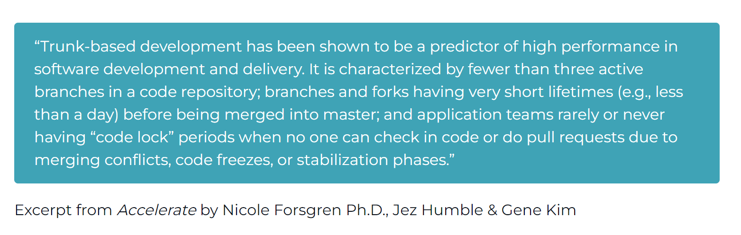
Trunk-Based Development
The Workflows
Fewer than 3 active branches
Branches/forks have very short lifetimes (less than a day)
Rare/no “code lock” periods
This implicitly means a lot more things like automated testing and feature flagging
Notes:
https://minimumcd.org/minimumcd/tbd/

Slide 29
Trunk-Based Development
TBD is not just a workflow, it's a method of development.
Smaller changes = small frequent changes easier to review
You must test = tests are part of the dev process
Better teamwork = more closely as a team
Better work definition = small changes require to decompose work into a level of detail that helps uncover things that lack clarity or do not make sense
Replaces process with engineering = control release of features through engineering techniques like branch by abstraction or feature flags.
Reduces risk = 2 risks with long-lived branches : problem with integration into the trunk (conflicts, loss of changes, ...) and abandoned branches.
The Workflows
Notes:
https://minimumcd.org/minimumcd/tbd/

Slide 30
Apps & Websites
Websites (GitHub, GitLab, BitBucket, ...)
Graphical User Interfaces (GitKraken, GitHub Desktop, SourceTree, ...)

Slide 31
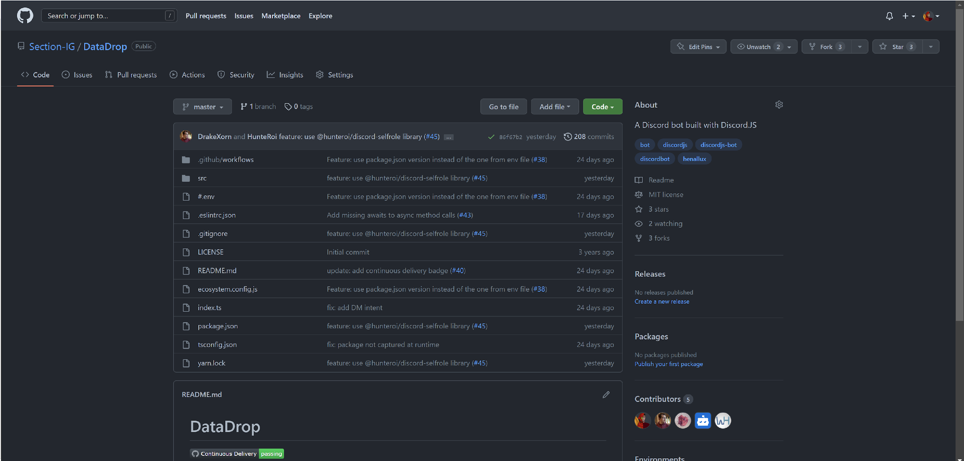
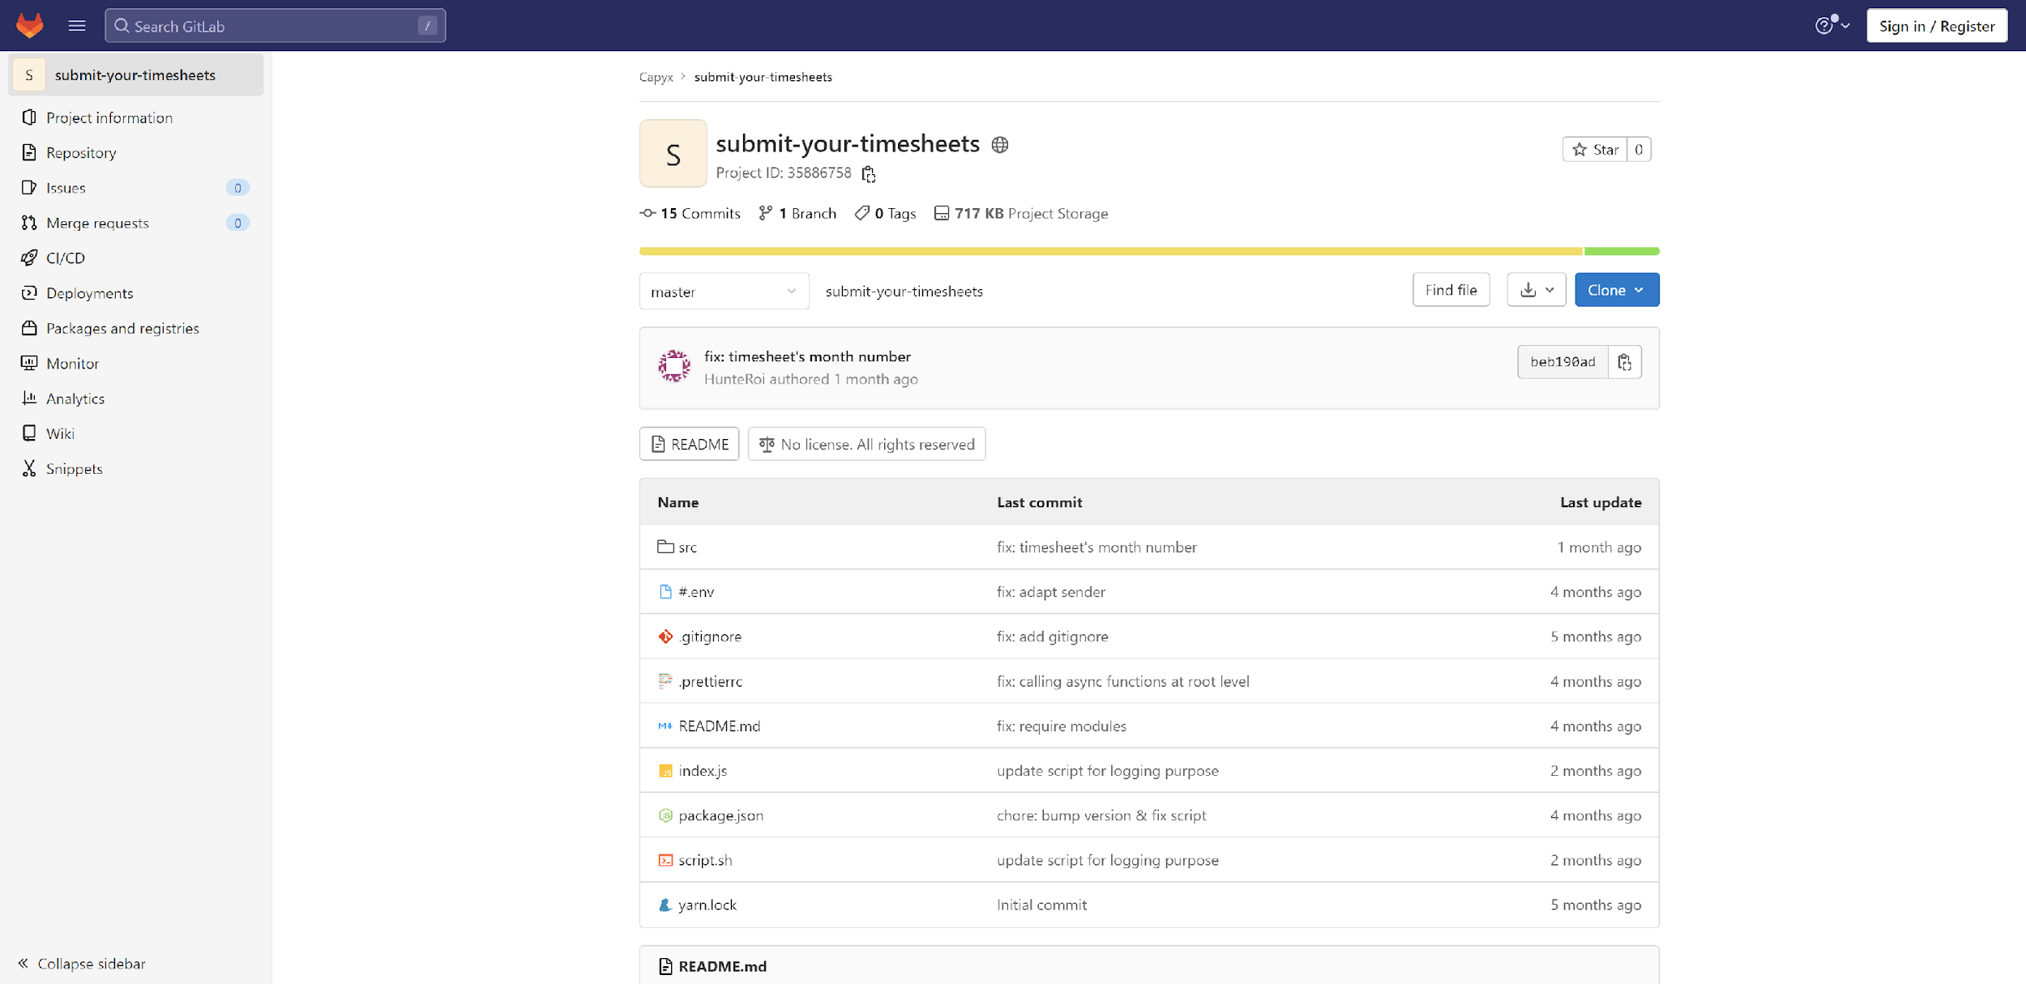
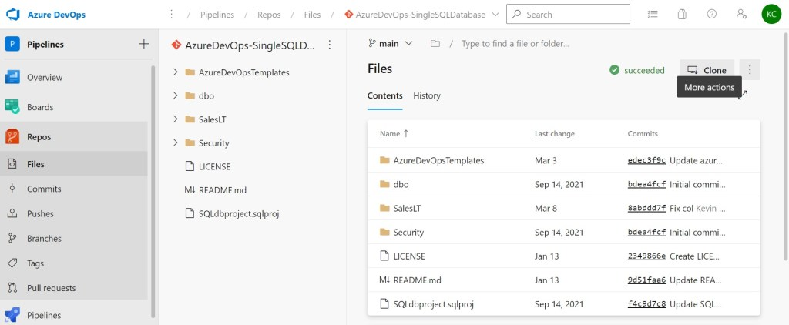
Websites
Git Hosting Services
GitHub
GitLab
Microsoft Azure DevOps
...
Apps & Websites
Notes:
https://www.git-tower.com/blog/git-hosting-services-compared/

Slide 32
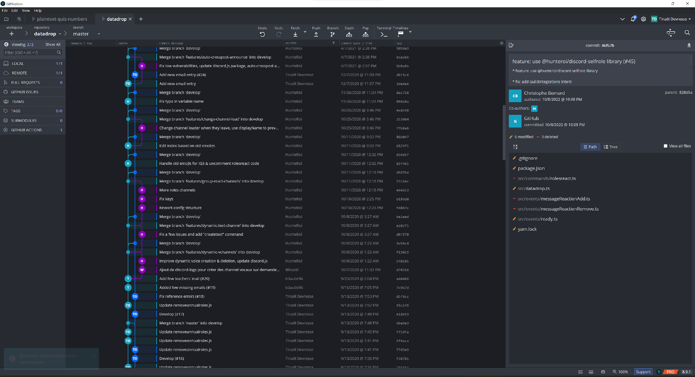
Graphical User Interfaces
Bye bye command-line-interface! Welcome GUI!
GitKraken
GitHub Desktop
SourceTree
...
Apps & Websites
Notes:
https://git-scm.com/downloads/guis

Slide 33
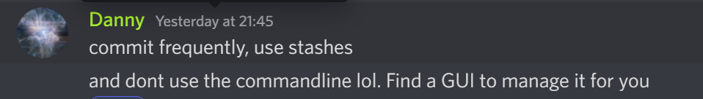
Feedback from Professionals

